Slide 1
Arguments For and Against
Trade Control/Protection
4.3
Copyright Bananaomics

Slide 2
Do you think free trade or trade protectionism is better? Explain your answer to a partner.
Copyright Bananaomics

Slide 3
Arguments For Trade Protectionism
protection of infant (sunrise) industries
national security
health and safety
environmental standards
anti-dumping
unfair competition
balance of payments correction
government revenue
protection of jobs
Economically least developed country (ELDC) diversification
Copyright Bananaomics

Slide 4
Protect Infant Industries
Infant Industry
An industry that has just entered the market and is not large enough to use economies of scale.
Due to this lack of economies of scale, infant industries have higher costs than more established firms. Governments may use administrative barriers to slow down more efficient firms with lower costs.
Copyright Bananaomics

Slide 5
National Security
The government may want to produce its vital and necessary goods in its own countries. Food is typically subsidized to ensure there is enough for the population. Military equipment is also typically produced domestically.
Copyright Bananaomics

Slide 6
Maintenance of Health & Safety
A country may impose certain health and safety regulations in order to keep its citizens safe. Certain countries may not allow certain goods or ingredients for import.
Copyright Bananaomics

Slide 7
Environmental Standards
A country may restrict importing products that are damaging to the global or domestic environment
Copyright Bananaomics

Slide 8
Anti-Dumping
Dumping
The situation when foreign firms export their goods at a price below production costs. Typically, established firms will do this and take the loss in revenue to establish grounding in a new market.
Certain protectionist measures could be put in place to reduce dumping.
Copyright Bananaomics

Slide 9
Unfair Competition
Some countries value patents and intellectual copyright more than others. Certain countries may not chose to allow imports that they deem to be "unfair" or "immoral".
Copyright Bananaomics

Slide 10
Balance of Payments Correction
Balance of Payments
In simple terms, the balance of payments is the flow of payments or money in and out of a country.
A country could use protectionist policies to limit the amount of money flowing out of the country.
Copyright Bananaomics

Slide 11
Government Revenue
Governments earn revenue from tariffs and therefore may choose to implement a tariff to create more revenue to fund government spending domestically.
Copyright Bananaomics

Slide 12
Protection of Jobs
When consumers choose to purchase foreign products, domestic producers earn less. Some domestic producers may be forced to lay off some workers due to a lack of revenue.
A government may implement protectionist policies to combat unemployment.
Copyright Bananaomics

Slide 13
ELDC Diversification
Economically Least Developed Countries may specifically choose against free trade as they need domestic producers to develop and grow their economy.
Copyright Bananaomics

Slide 14
Arguments Againt Trade Protectionism
misallocation of resources
retaliation
increased costs
higher prices
less choice
domestic firms lack the incentive to become more efficient
reduced export competitiveness
Copyright Bananaomics

Slide 15
Misallocation of Resources
Consumers demand greater quantities of goods at lower prices. Foreign importers can typically offer those goods at lower prices compared to domestic producers but protectionist policies prevent the allocation of resources.
Copyright Bananaomics

Slide 16
Retaliation
When one country imposes tariffs or quotas, the trading partner may retaliate causing a 'trade war'. Trade wars often lead to higher prices for both parties, an increase in production costs and potentially unemployment.
Copyright Bananaomics

Slide 17
Increased Cost
When raw materials have a tariff or quota imposed on them, cost of production increases.
Copyright Bananaomics

Slide 18
Higher Prices
Consumers must pay a higher price for a good than they should compared to free trade.
Copyright Bananaomics

Slide 19
Less Choice
Protectionism limits imports and choices for domestic consumers. These policies limit the variety of goods available.
Copyright Bananaomics

Slide 20
Less Incentive for Domestic Producers to Improve
Protectionist policies limit competition from international competition and provides no incentive for domestic producers to improve efficiency, quality, or engage in research and development.
Copyright Bananaomics

Slide 21
Reduced export competitiveness
As your country's producers pay more for imported materials, domestic producers must charge higher prices to cover increased costs. This increase in price leads to a less competitive market for exports.
Copyright Bananaomics

Slide 22
How to Enrich a Country: Free Trade or Protectionism?
The School of Life
Copyright Bananaomics

Slide 23
Free Trade VS Protectionism
Socratic Seminar
Copyright Bananaomics

Slide 24
Free Trade VS Protectionism
Copyright Bananaomics

Slide 25
Practice Question
Copyright Bananaomics

Slide 26
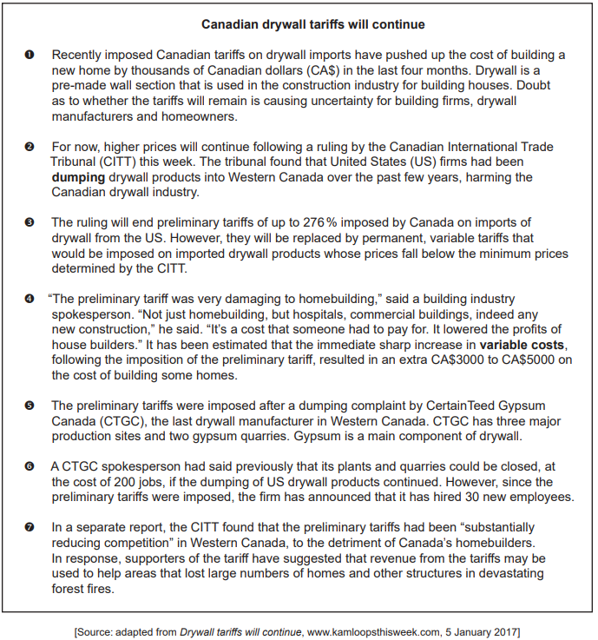
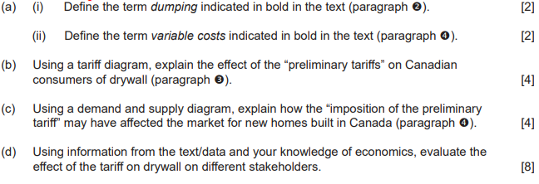
Paper 2
Copyright Bananaomics

Slide 27
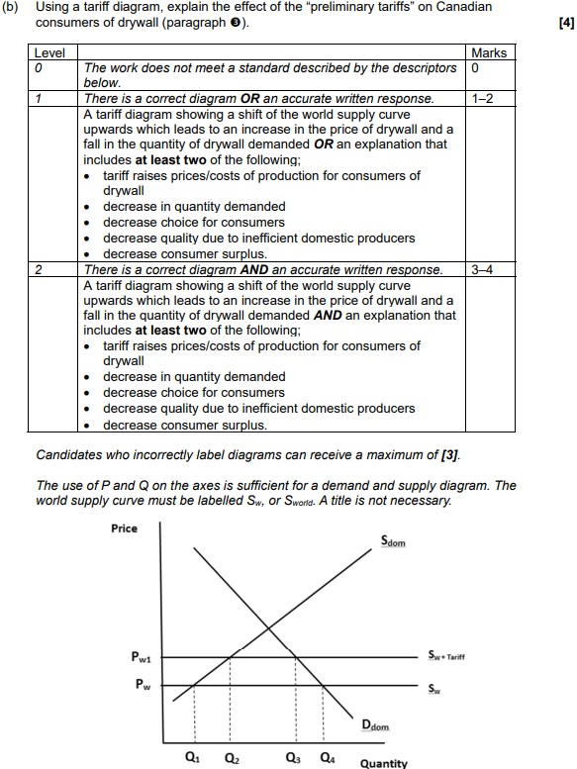
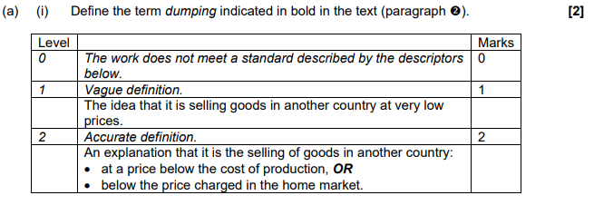
Mark Scheme
Copyright Bananaomics

Slide 28
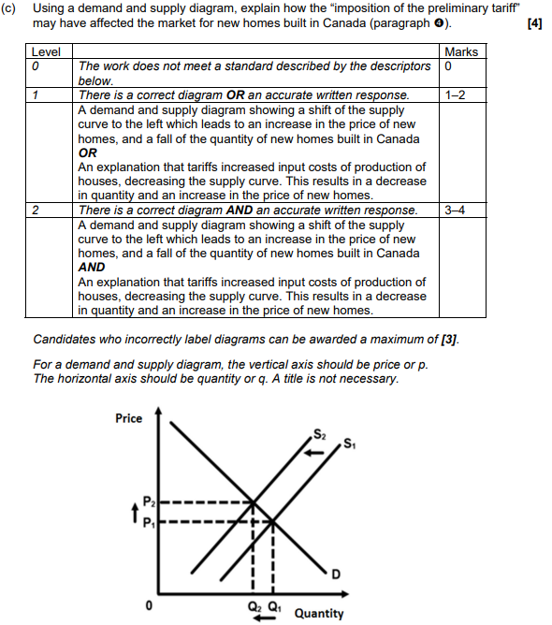
Copyright Bananaomics

Slide 29
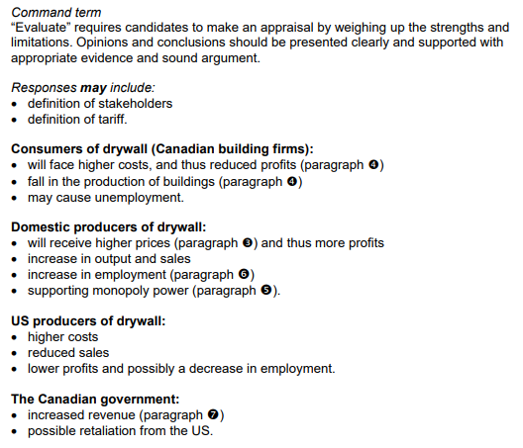
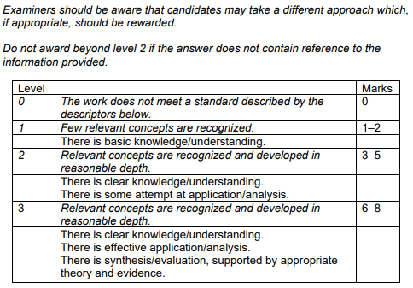
Copyright Bananaomics

Slide 30
Enjoying The Content?
Visit bananaomics.com to purchase package deals with discount prices!
BANANAOMICS

